Slide 1
ONE BHARAT DS ASSIGNMENT Submission By : Divjot kaur
Email : divjotbhullar006@gmail.com
The entire report was created using pandas, numpy, matplotlib, and seaborn in Python for data analysis and visualization.
To access the code for this report visit the GitHub link: https://github.com/DivKjot/DS-assignments
The results are displayed in this PowerPoint presentation.

Slide 2
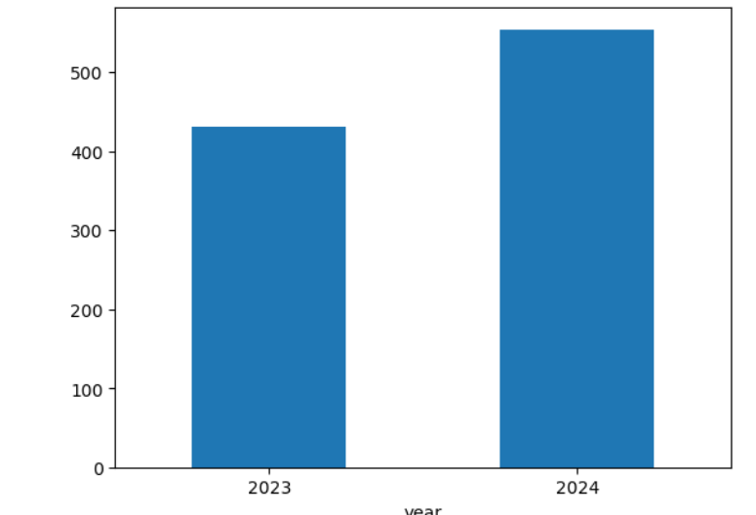
Bank Statement Analysis
Transaction Analysis
What is the total number of transactions made over the year?
Year No. of Transactions:
2023 431
2024 554
There is a Increase of 123 transactions from the year 2023 to 2024.

Slide 3
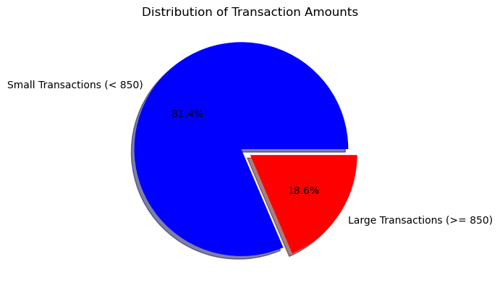
What is the distribution of transaction amounts (e.g., small vs. large transactions)?(define small and large transactions by yourself)
let transactions amount < 850 be "Small"
let transactions amount >= 850 be "Large"
Here number of small transactions : 802
Number of large transactions : 183

Slide 4
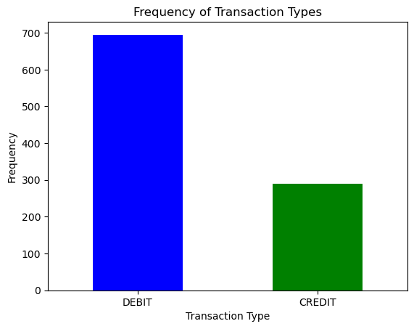
Analyze the frequency of different transaction types (debit vs. credit).
DEBIT 695
CREDIT 290

Slide 5
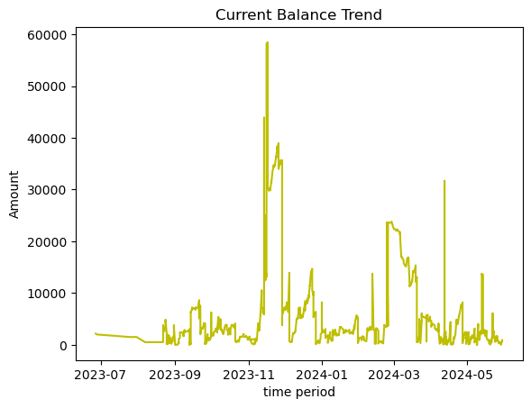
Balance Analysis
The current balance trend shows significant fluctuations, characterized by a sharp increase in November 2023 followed by a pronounced decrease in December 2023.
Despite of sharp spikes at some point of time the average balance remains around Rs. 5901
What is the trend of the account balance over time?

Slide 6
Spending Patterns
What are the main categories of expenses (e.g., fuel, Ecommerce, food, shopping, ATM withdrawals, UPI transactions)?
type mode
CREDIT OTHERS 188
UPI 101
CASH 1
DEBIT UPI 688
CARD 4
ATM 3

Slide 7
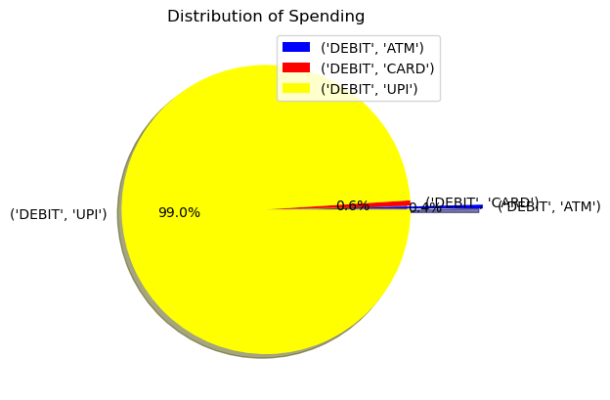
Spendings:type mode : DEBIT
ATM 3
CARD 4
UPI 688
Analyze the frequency and amount of spending in each category.
UPI is the most commonly used method for spending and CASH is the least used method for spending by customers. Indicating a transformation towards a cashless economy.

Slide 8
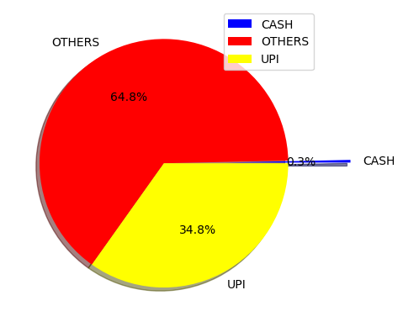
Income Analysis
What are the main sources of income (e.g., salary, UPI credits)?
Income:
mode
CASH 1
OTHERS 188
UPI 101
Income received from the others methods is the highest which might include Salary ,receipts etc. UPI is the 2nd most common source of income .
CASH is again the least used method for receiving Income by customers.
Only 0.3% of the total payments received are cash Payments

Slide 9
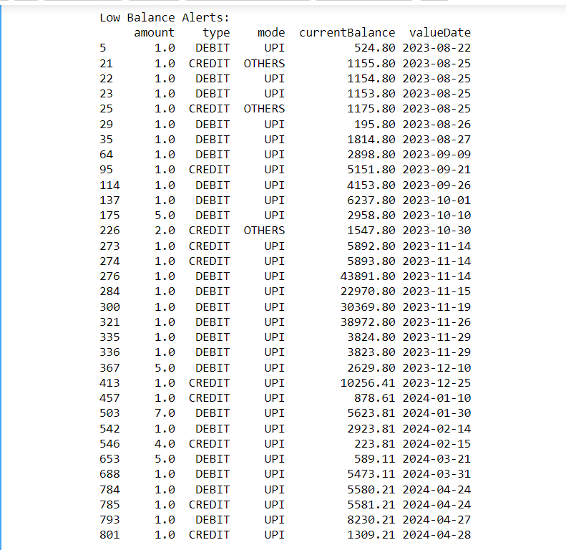
Alert Generation
A Low Alert is generated for transactions with amount less than Rs. 10.
This table displays the type (Credit or Debit) of Low transactions along with mode and current balance.
Since the number of low transaction are quite large the bank can decide to increase the limit for such transactions as they increases the non-beneficial traffic on the site.
Generate alerts for low balance or high expenditure periods.
LOW balance Alert is created for transactions with amount < Rs. 10

Slide 10
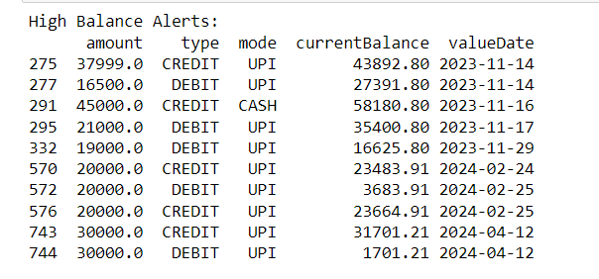
High balance Alert is created for transactions with amount > Rs. 15000
A High Alert is generated for transactions with amount more than Rs. 15000.
This table displays the type (Credit or Debit) of High transactions along with mode and current balance.
Bank can decide to offer special discounts to such customers making high amount of transactions.

Slide 11
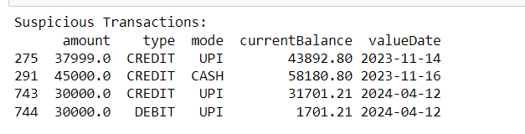
Identify any unusual or suspicious transactions.
Suspicion Alert for all transactions with amount exceeding Rs.25000
A suspicion Alert is generated for transactions with amount exceeding not only the high threshold of Rs. 15000 but also an amount of Rs. 25000.
This displays the type of suspicion transactions along with mode and current balance.
Bank may decide to monitor the activities of such customers and further investigation.

Slide 12
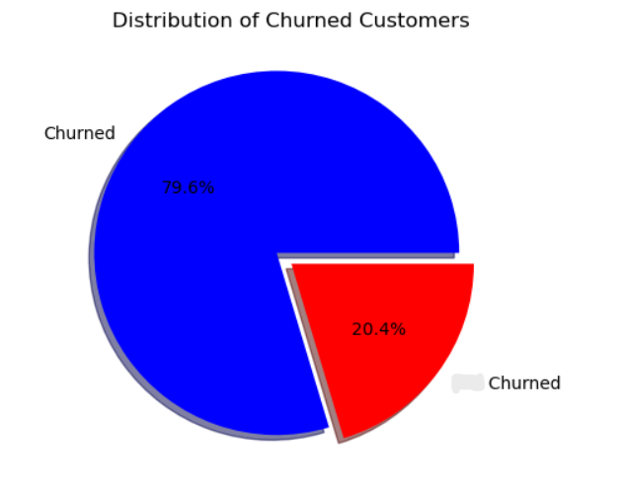
Churn Modelling Data Analysis
Distribution of customers(churned / Not churned)
Churned (status 1) : 2037
Not – Churned (status 0) : 7963
Number of customers Churned is < Number of customers not churned
but number Churned customers are in significant numbers which indicates that there is a need for the company to change its measures to reduce the rate of churned customers.
not

Slide 13
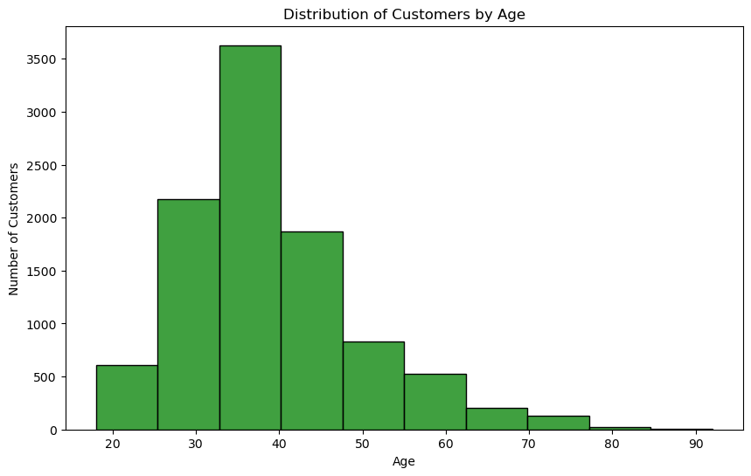
What is the distribution of customers across different age groups?
Histogram is used to show the distribution of customers across different age groups majority of the customers lie in age group of 25-45 and very few are above the age of 65 (senior citizens)

Slide 14
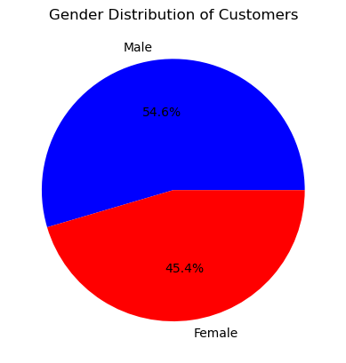
Analyze the gender distribution of customers.
No. of Male : 5457
No. of Female : 4543
Distribution of male and female customers is quite well distributed there is no gender based bias.

Slide 15
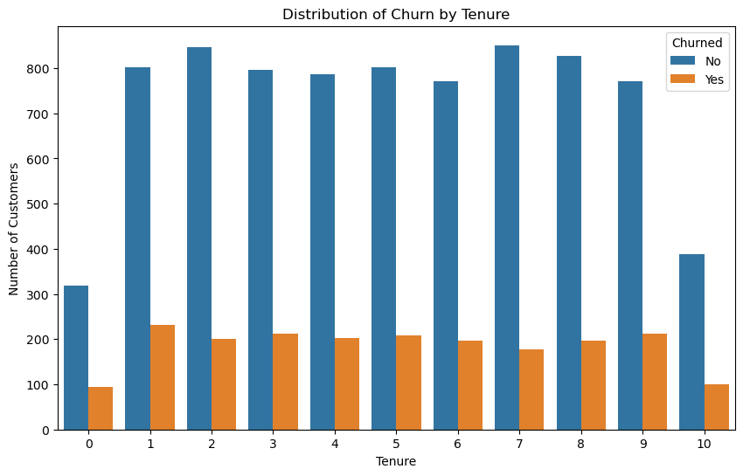
What percentage of customers have churned?
Percentage of customers who have churned : 20.3697
What are the main reasons for customer churn?
In order to identify the reason for churned customer let us examine various measures such as Tenure ,Geography and Gender
Customers with higher Tenure rate do not churn often indicating customer loyality.
Company should provide discounts on long term schemes in order to retain customers for longer duration and inturn reduce the churning rate.

Slide 16
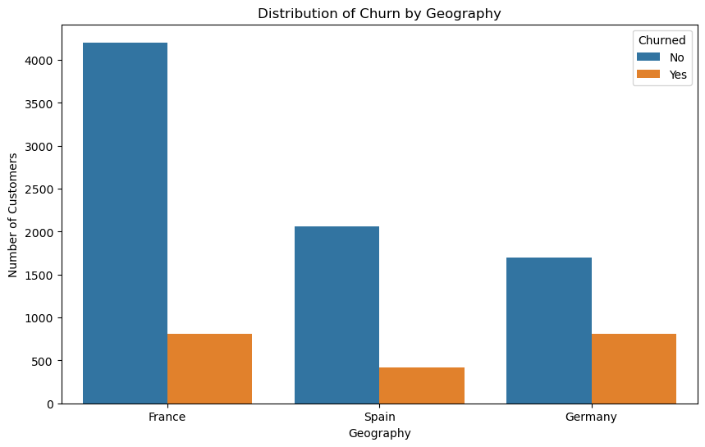
Distribution of Churn by Geography:
France has the least churn rate indicating that company has well researched the market in that location and customers are happy.
Whereas Germany has the Highest churning rate indicating that the Company should adopt methods to understand the customer needs and adopt methods to reduce the churn rate as the Churned customers increases the cost for the company.

Slide 17
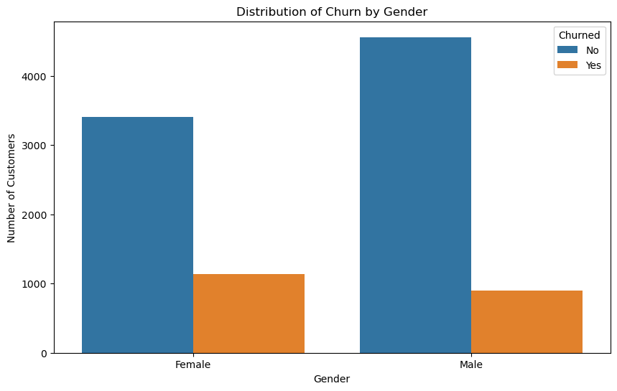
Gender based churned rate is not significant
Churning rate is higher in females as compared to males suggesting that company could include products/services to cater to the female customers as well.

Slide 18
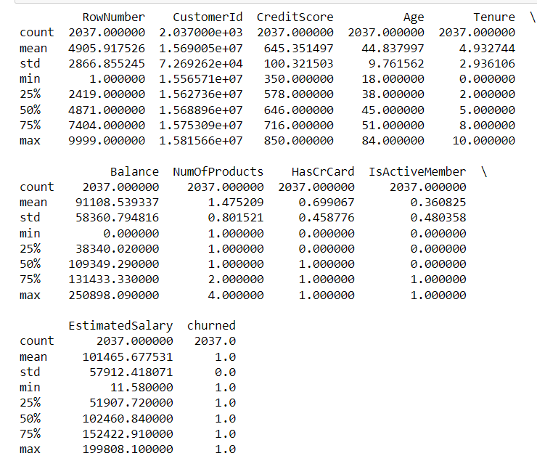
Trends among customers who have churned.

Slide 19
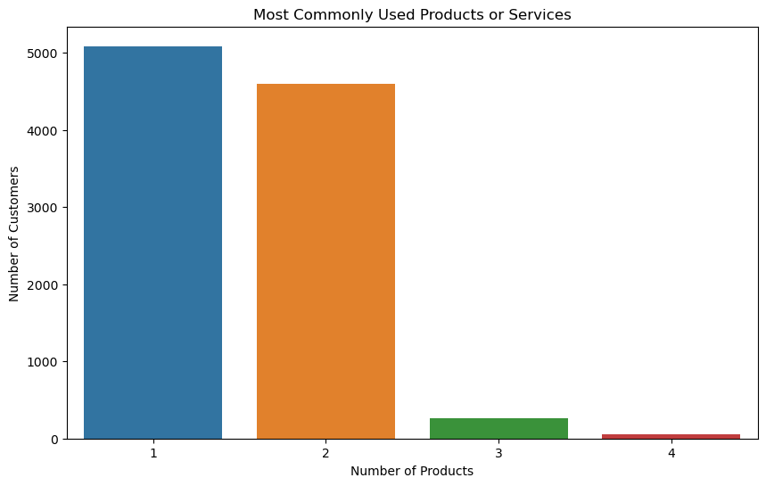
What are the most commonly used products or services?
Product id 1 and 2 are the most famous products among customers company can eliminate the least populous products among the customers.

Slide 20
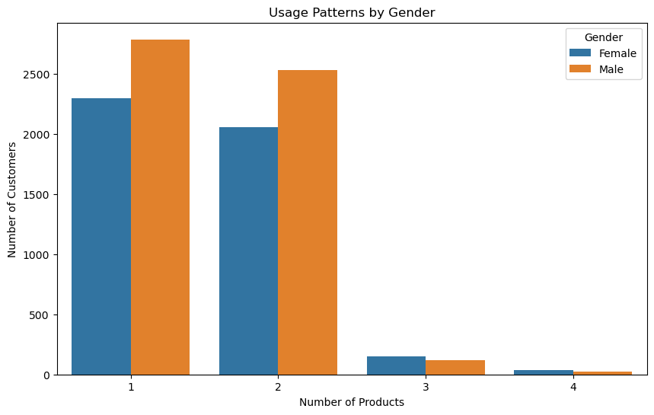
Analyze the usage patterns of different customer segments.
Usage patterns of different customer by GENDER:
There is no significant difference in the preference of different products among male or female both prefer product 1 and 2 over 3 and 4.

Slide 21
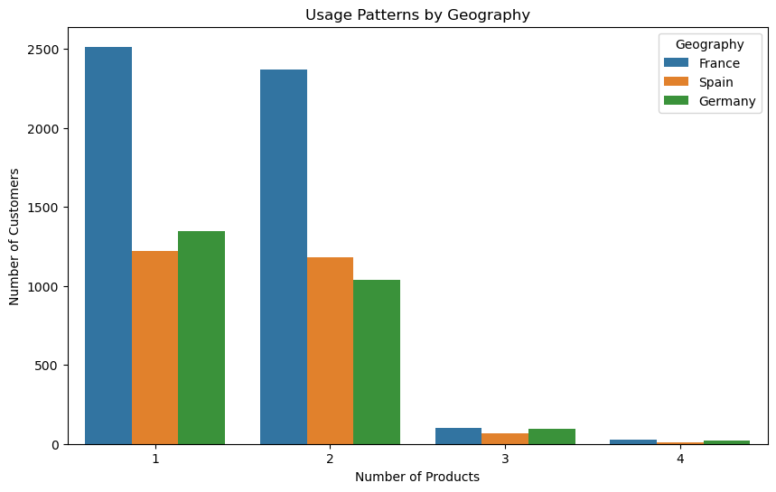
Usage patterns of different customer by GEOGRAPHY:
Product 1 and 2 are most preferred in all the locations .

Slide 22
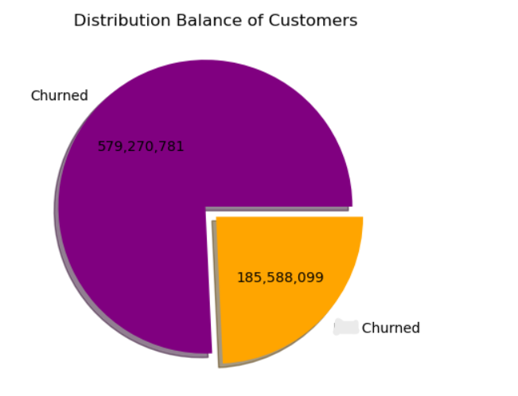
What is the average account balance of customers?
Average account balance of customers: Rs76485.89
Compare the financial characteristics of churned vs. non-churned customers.
Churned (status 1) : 185,588,094.63
Not – Churned (status 0) : 579,270,798.25
Not

Slide 23
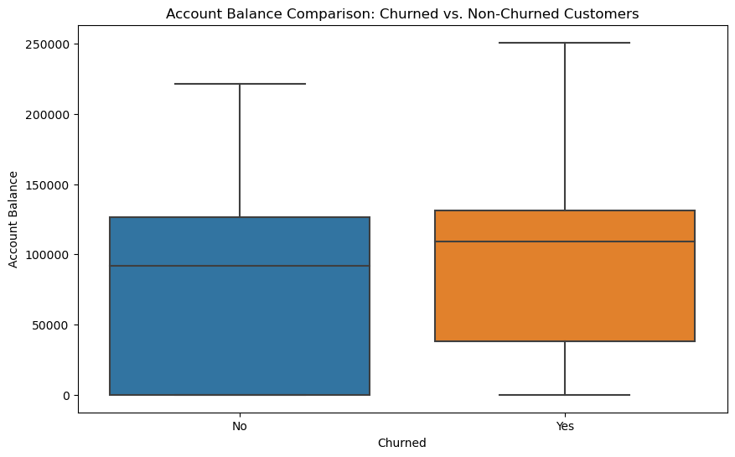
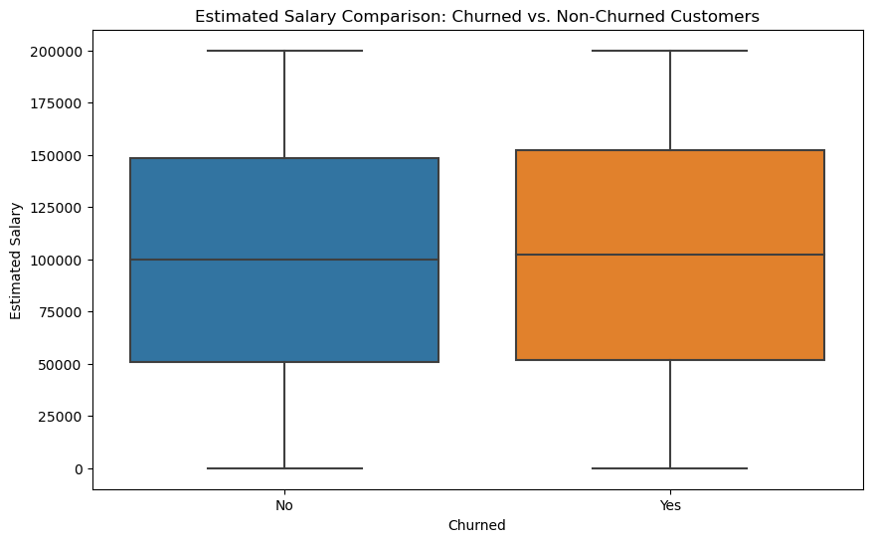
financial characteristics of churned vs. non-churned customers.
The churned and non-churned customers have a balance of 1 Lac (slightly below and above respect)
The min bal for churned and non-churned customers is 50k and 0 resp
The churned and non-churned customers have an approximate salary of 1 Lac with min being 50K and max around 1.5 Lac
There is no significant difference between the two groups on basis of their estimated salary.

Slide 24
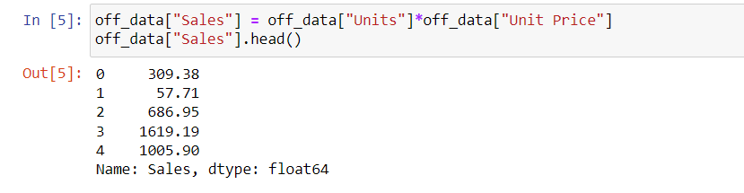
Office Supplies Data Analysis
Sales Analysis
Sales column is obtained by multiplication of price and units column.

Slide 25
What are the total sales for each product category?
ITEM SALES
Binder 9577.65
Desk 1700.00
Pen 2045.22
Pen Set 4169.87
Pencil 2135.14
Which product category has the highest sales?
Item with highest sales is Binder with sales amount = Rs. 9577.65

Slide 26
Identify the top 3 best-selling products.
ITEM SALES
Binder 9577.65
Pen Set 4169.87
Pencil 2135.14

Slide 27
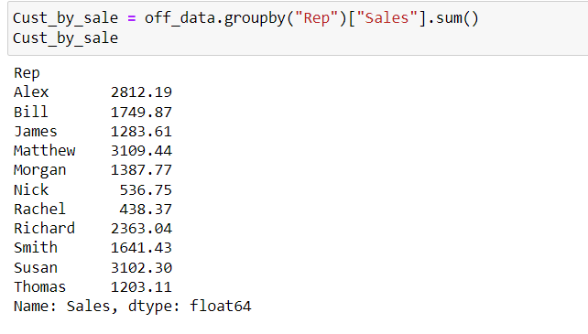
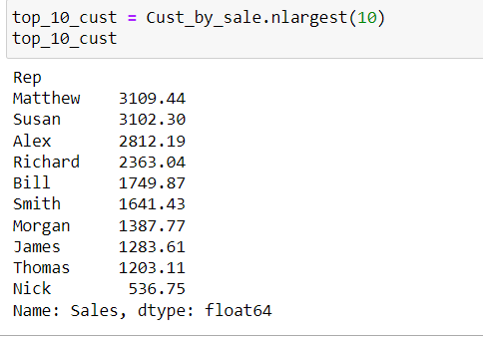
Customer Analysis
Who are the top 10 customers by sales?

Slide 28
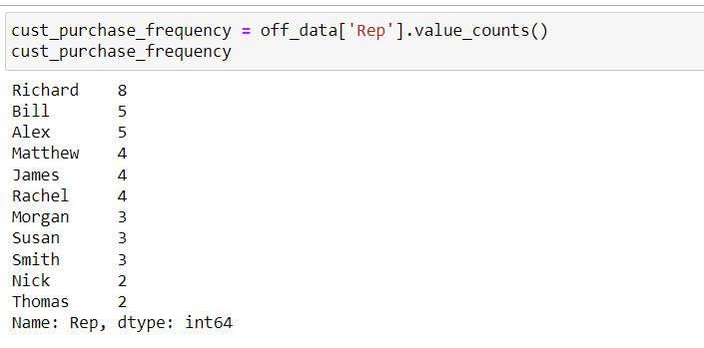
What is the total number of unique customers?
There is a total of 11 unique customers.
Analyze customer purchase frequency.
Richard is the most frequent customer .

Slide 29
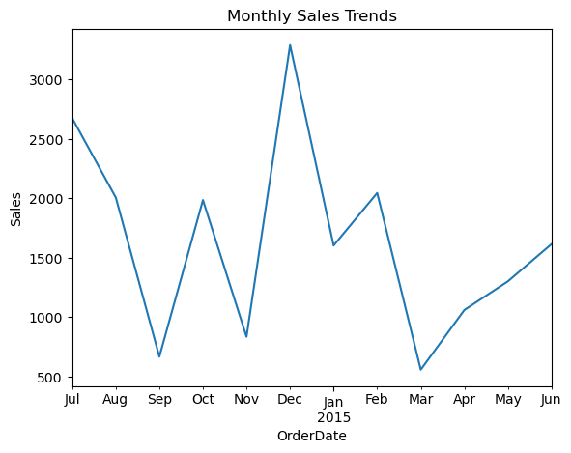
Time Series Analysis
What are the monthly sales trends over the past year?
Fluctuations in the sales amount are quite significant during the business cycle .
Sep , nov ,March have the least sales
Dec has the max Sales .
From Dec onwards sales starts to fall till march and then rose subsequentially.
A cyclic pattern could be observed .

Slide 30
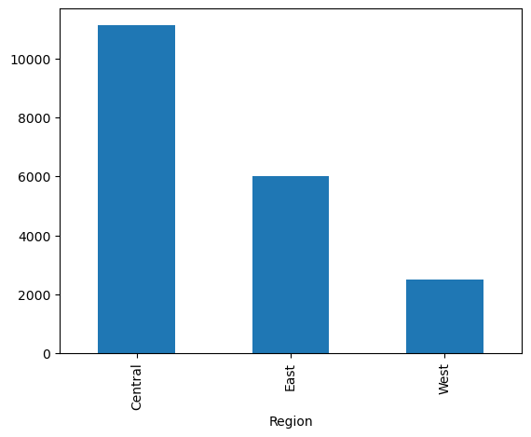
Geographical Analysis
Which regions generate the most sales?
What are the sales trends across different regions?
REGION SALES
Central 11139.07
East 6002.09
West 2486.72
Central is the region with max sale of amount = Rs. 11139.07

Slide 31
THANKYOU!

